Slide 1
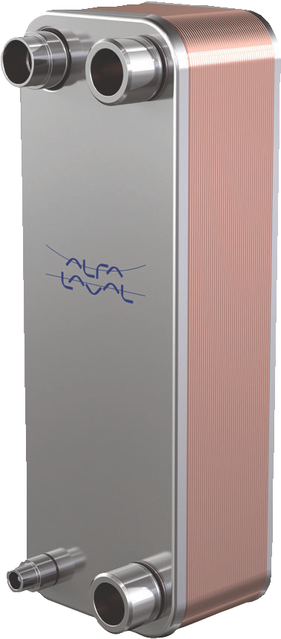














Alfa Laval SE43
Brazed plate heat exchanger for air conditioning and refrigeration
空调和制冷用钎焊板式换热器
Introduction
引言
Alfa Laval SE brazed plate heat exchangers provide efficient heat transfer with a small footprint. They are specifically designed to work as evaporators and condensers in applications such as chillers and heat pumps.
阿法拉伐SE钎焊板换热器具有占地面积小和有效的传热的特点。特殊的设计使其可在冷却器和热泵应用中作为蒸发器和冷凝器使用。
The Alfa Laval SE product line is thermally optimized for propane. It offers design and technical features specifically with safety in mind.
经过热优化， Alfa Laval SE生产线适用于丙烷。设计和技术功能特别考虑了安全因素。
Applications Benefits
应用 优势
Compact
紧凑型设计
Easy to install
易于安装
Self-cleaning
自清洁
Low level of service and maintenance is required
降低服务和维护等级
All units are pressure and leak tested
所有部件都经过压力和泄漏测试
Gasket free
无垫片
Branded Features
品牌特性
DynaStatic™
Flexible refrigerant distribution
柔性制冷剂分配
is specifically important when using propane, and lower pressure drop on the water or brine side, reducing the CO₂ footprint.
这在使用丙烷时尤为重要。并且还可降低水或盐水侧的压降，进而减少了二氧化碳足迹。
FlexFlow™
Superior thermal performance
优越的热性能
The product provides high performance, such as high evaporation temperature and low condensing temperature, which over its life time results in reduced environmental impact and lower operational cost
该产品具有高蒸发温度和低冷凝温度等高性能，可在其使用寿命内降低对环境的影响并降低运行成本。
Classified by Alfa Laval as: Business
IceSafe
Controlled, non-destructive freezing
受控、非破坏性冷冻
PressureSecure
Unparalleled strength for demanding duties
无与伦比的功能，可完成高难度任务
The integrated distribution system ensures an even distribution of the refrigerant throughout the plate package.
集成式分配系统可确保制冷剂在整个板组内均匀分布。
REFuture
A future-proof investment for tomorrow’s refrigerants
为未来的制冷剂投资
Based on standard components and a modular concept, each unit is custom-built to meet the specific requirements of each individual installation.
每个单元都是根据标准组件和模块化概念定制的，以满足每个独特装置的具体要求。
ValuePlus
Total support – with value-adding options to fit your needs
全面支持-提供增值选项，以满足您的需求
Design
设计
The brazing material seals and holds the plates together at the contact points ensuring optimal heat transfer efficiency and pressure resistance. Using advanced design technologies and extensive verification guarantees the highest performance and longest possible service life.
钎焊材料将板片密封固定在接触点处，确保最佳的传热效率和耐压性。以上这些特点，加之先进的设计工艺和广泛验证可保证性能最佳和最长的使用期限。
Optimized for propane.
针对丙烷优化。
Examples of connections
接头示例
Asymmetric channels provide optimal efficiency in the most compact design. This results in low refrigerant charge, which
最紧凑的设计及非对称通道可实现最佳效率，并降低制冷剂充注量。
External thread
外螺纹
Internal thread
内螺纹
Soldering
钎焊
Welding
焊接

Slide 2
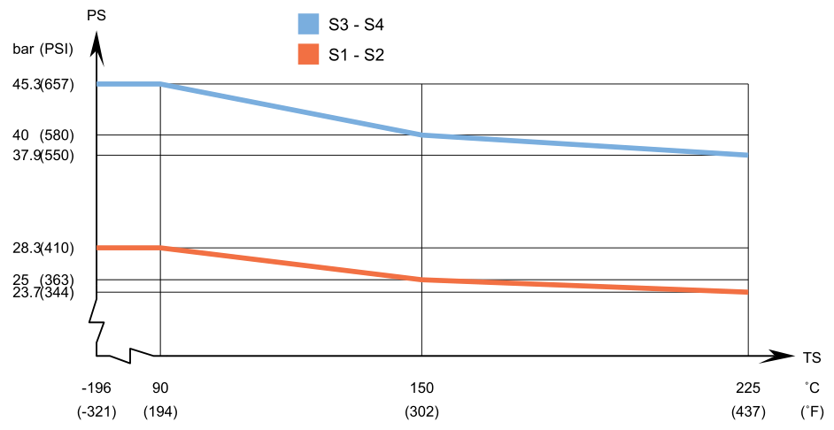
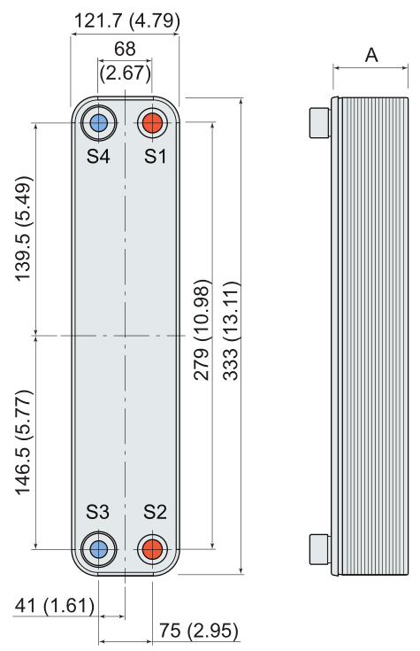
Design pressure and temperature
设计压力和温度
SE43 – PED approval pressure/temperature graph
SE43 – PED 批准压力/温度图
Technical Data
技术参数
Standard materials
标准材料
Cover plates 盖板 Stainless steel 不锈钢
Connections 接头 Stainless steel 不锈钢
Plates 板 Stainless steel 不锈钢
Brazing filler 钎料 Copper 铜
Dimensions and weight ¹
尺寸和重量 ¹
A-measurement (mm) A-测量(mm) 12.5 + (1.22 * n)
A-measurement (inches) A-测量(in) 0.49 + (0.05 * n)
Weight (kg) 2 重量(kg) 2 1.4 + (0.09 * n)
Weight (lb) 2 重量(lb) 2 3.09 + (0.20 * n)
n = number of plates n = 板数 Excluding connections 不包括接头
Standard data
标准数据
Designed for full vacuum.
全真空设计。
Volume per channel, litres (gal)
各通道容量，升（加仑）
(S1–S2) 0.0418 (0.0110)
(S3–S4) 0.0263 (0.0069)
Alfa Laval plate heat exchangers are available with a wide range of pressure vessel approvals. Please contact your Alfa Laval representative for more information.
阿法拉伐板式换热器获得了各种压力容器批准。如需更多信息，请联系您的阿法拉伐代表。
NOTE: Values above are to be used as an indication. For exact values, please use the drawing generated by the Alfa Laval configurator or contact your local Alfa Laval representative.
注：以上值仅用于指示。具体数值，请参见阿法拉伐配置器生成的图纸或联系您当地的阿法拉伐代表。
Max. particle size, mm (inch)
最大粒径，mm（in）
0.5 (0.020)
Max. flowrate 1 m3/h (gpm)
最大流量 1 m³/h (gpm)
8.8 (38.7)
Flow direction
流向
Parallel
并联
Min. number of plates
最少板数
4
Max. number of plates
最多板数
120
¹ Water at 5 m/s (16.4 ft/s) (connection velocity)
¹ 5 m/s (16.4 ft/s) （接头速度）下的水
Dimensional drawing
尺寸图
Measurements in mm (inches)
测量值，单位：mm（in）
This document and its contents are subject to copyrights and other intellectual property rights owned by Alfa Laval AB (publ) or any of its affiliates (jointly “Alfa Laval”). No part of this document may be copied, re-produced or transmitted in any form or by any means, or for any purpose, without Alfa Laval’s prior express written permission. Information and services provided in this document are made as a benefit and service to the user, and no representations or warranties are made about the accuracy or suitability of this information and these services for any purpose. All rights are reserved.
本文件及其内容受阿法拉伐公司[Alfa Laval AB (publ)]或其任何关联公司(合称“阿法拉伐”)拥有的版权和其他知识产权的约束。未经阿法拉伐事先明确书面许可，不得以任何形式、任何方式或出于任何目的复制、重新制作或传播本文件的任何部分。本文件所述信息和服务旨在为用户提供利益和服务。对于该等信息及服务的准确性和适用性，阿法拉伐集团公司不做任何声明与保证。版权所有。
200013484-1-EN-GB © Alfa Laval AB
How to contact Alfa Laval
如何联系阿法拉伐
www.alfalaval.com
请登录www.alfalaval.com获取阿法拉伐各国分支机构的最新联系信息。

